Slide 1
Release Note by
KX-NS Version 6.0
Product Specification
February 27, 2018
Panasonic
Business Communication BU
Specifications are subject to be changed without a notice.

Slide 2
1. Table of Contents for KX-NS
Chapter | Contents | KX-NS300 KX-NS500 KX-NS700 | KX-NS1000 Version 6.01
1 to 4 | ACD Report Improvement | Version 6.00 | Yes
5 | Remote maintenance via KMS | (Version 4.5) | Yes (*)
6 | Push Notification for KX-UCMA mobile softphone | (Version 5.0) | Yes (*)
7 | SIP TLS |  | Yes (*)
8 | Built-in PMSi |  | Yes (*)
9 | Other technical improvement | See next page. | See next page.
(*) V-UTEXT cards have to be disabled for these features.
This condition is applied for KX-NS1000 and KX-NS300/500/700 in KX-NS1000 one look network.
KX-UT SIP phone can work with V-SIPEXT card without DSS/CO key.
Notes:
2

Slide 3
2. Table of Contents for KX-NS
No. | Contents | KX-NS300 KX-NS500 KX-NS700 | KX-NS1000 Version 6.01
91 | Selected flexible key copy | Version 6.00 | Yes
92 | Disable call from VM to Trunk | Version 6.00 | Yes
93 | QoS | Version 6.01 | Yes
94 | Stronger security for Web-MC remote connection | Version 6.01 | Yes
95 | System data transfer by Easy setup | Version 6.01 | Yes
96 | CSV for KX-NT registration | Version 6.01 | Yes
Above features work regardless of V-UTEXT cards.
Notes:
3

Slide 4
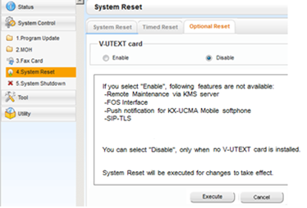
3. KX-NS1000 : V-UTEXT card
V-UTEXT cards can be enabled instead of new features in previous page. Default is disabled.
System restart is required to change this mode.
< When software is upgraded, >
KX-NS1000 V5 or older KX-NS1000 V6 or later
with V-UTEXT “Enable” automatically (New features do NOT work.)
w/o V-UTEXT “Disable” automatically (New features work. )
Notes:
4

Slide 5
Chapter 1
ACD Report (Summary)

Slide 6
11. ACD Report Enhancement
Built-in ACD report (for ICD group call only) is improved as Advanced Call Detailed Report for any types of customers.
- Incoming call from trunk to ICD group
- Direct Incoming call from trunk to extension
- Outgoing call to trunk
It reports call charge also.
Report can be e-mailed from PBX to e-mail address of ACD supervisor automatically.
For example, report of last month can be e-mailed at the beginning of every month.
Notes:
6

Slide 7

12. ACD Report Feature Summary (1)
User
Charge Group
Report Type Conditions |  | Group | Call | User (New) |  | Charge (New)
Each report is made based on these trunk calls. | Outgoing call | -- | -- | -- | Yes | Yes
 | Direct incoming call | -- | -- | -- | Yes | Yes
 | Group incoming call | Yes | Yes | Yes | Yes | Yes
Each report is made for these items. | Call status except charge | Yes | Yes | Yes | Yes | --
 | Charge | -- | -- | -- | Yes | Yes
Required AK |  | AK1 | AK1 | AK1 | AK1 & AK2 | AK3
AK1 : KX-NSF201 or KX-NSXF022 (ACD report)
AK2 : KX-NSXF023 (New AK for ACD Enhance)
AK3 : KX-NSXF202 (New AK for Charge report)
Notes:
7

Slide 8
13. ACD Report Feature Summary (2)
Report Type Conditions |  | Group | Call | User (New) |  | Charge (New)
Each report is made by these method. |  | Yes | Yes | Yes | Yes | Yes
 |  | Yes | Yes | Yes | Yes | --
 |  | Yes | Yes | -- | -- | --
 |  | Yes | -- | -- | -- | --
 |  | -- | -- | -- | Yes | Yes
Required AK |  | AK1 | AK1 | AK1 | AK1 & AK2 | AK3
See chapter 2 for details.
AK1 : KX-NSF201 or KX-NSXF022 (ACD report)
AK2 : KX-NSXF023 (New AK for ACD Enhance)
AK3 : KX-NSXF202 (New AK for Charge report)
Notes:
8

Slide 9
Chapter 2
User Report & Charge Report

Slide 10
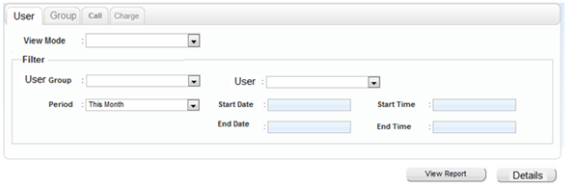
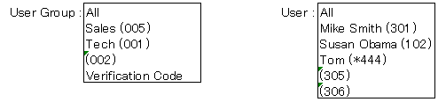
21. User Report : View mode & Filter
Extension based report is added. (Not for ICD group agent)
Total of each user group also can be reported when View mode is “Standard”.
“Standard” or “Date” can be selected for View mode.
Hour / Day / Month are not supported for View mode of User Report.

Slide 11
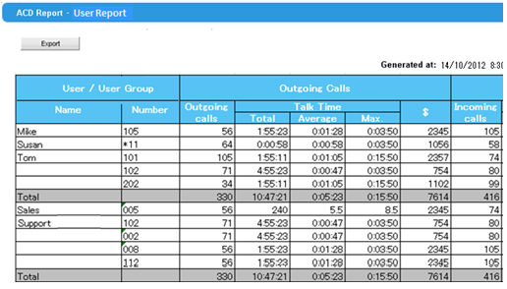
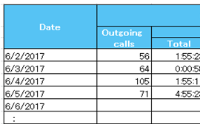
22. User Report : GUI Example
GUI example for report is as follows.
View mode : Standard View mode : Date

Slide 12

23. User Report : Contents (1)
AK
Required
Reported contents and required AK are as follows.
Call (Log) Type | Reported Contents | Required AK
Incoming call (Answered) Both ICD call and direct call | Number of calls | AK1 is required.
 | Talk Time (Total / Average / max.)
 | Ring Time (Total / Average / max.) | Both AK1 & AK2 are required. These are new compare to current Agent report.
 | $
Incoming direct call (No Answered) | Number of calls
 | Ring Time (Total / Average / max.)
Outgoing call | Number of calls
 | Talk Time (Total / Average / max.)
 | $
Incoming + Outgoing | Talk Time (Total)
 | $
AK1 : KX-NSF201 or KX-NSXF022 (ACD report)
AK2 : KX-NSXF023 (New AK for ACD Enhance)

Slide 13
24. User Report : Contents (2)
AK
Required
Reported contents and required AK are as follows.
Call (Log) Type | Reported Contents | Required AK
ICD group Log-in (*1) | First Log-in time (*2) from 00:00 to 23:59 | AK1 is required.
 | Last Log-out time (*2) from 03:00 to 26:59
 | Log-in duration (*3)
 | Not ready duration
 | Wrap-up duration
*1) When one user belongs to 2 or more ICD groups, smallest group number
is applied.
*2) This is applied when view mode is “Date” and one user is selected.
*3) Log-in duration for the date is counted from 00:00 to 23:59. (Same as log-in time)
AK1 : KX-NSF201 or KX-NSXF022 (ACD report)
AK2 : KX-NSXF023 (New AK for ACD Enhance)

Slide 14
25. User Report : [Details] button
AK
Required
Call details can be reported by CSV using [Details] button.
- Call Type (Incoming No Answer / Answer / Outgoing)
- Date and time
- Extension number & name or Verification code & name
- Trunk
- Phone number of trunk side
- Ring duration
- Talk duration
- Charge $
- ICD group number
if ICD group call
Type | Date | Time | Extension | Name | Trunk | Phone number | …
Incoming No Answered | 2017/6/29 | 23:35 | 101 | Mike | 1 | 012345678
Outgoing | 2017/6/30 | 7:12 | *333 | Susan | 12 | 201333444
Outgoing | 2017/6/30 | 7:20 | 301 | Tom | 4 | 123456789
Incoming Answered | 2017/6/30 | 8:05 | 102 | Beth | 5
Both AK1 and AK2 are required.
AK1 : KX-NSF201 or KX-NSXF022 (ACD report)
AK2 : KX-NSXF023 (New AK for ACD Enhance)

Slide 15
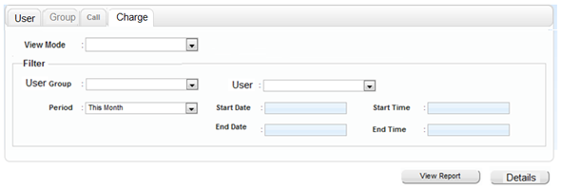
26. Charge Report
AK
Required
Charge report is simpler report than User report.
[View Report] : Only charge is reported. [Details] : Same as User Report
<View Report>
User |  | Outgoing $ | Incoming $ | Sub- total
Beth | 102 | 123.45 | 1.11 | 124.67
Mike | 101 | 11.11 | 0.00 | 11.11
Susan | *333 | 11.11 | 22.22 | 33.33
 | 301 | 222.22 | 0.11 | 222.33
Only AK3 is required for [View Report] and [Details].
AK1 : KX-NSF201 or KX-NSXF022 (ACD report)
AK2 : KX-NSXF023 (New AK for ACD Enhance)
AK3 : KX-NSXF202 (New AK for Charge report)

Slide 16
Chapter 3
ACD Report by E-mail

Slide 17
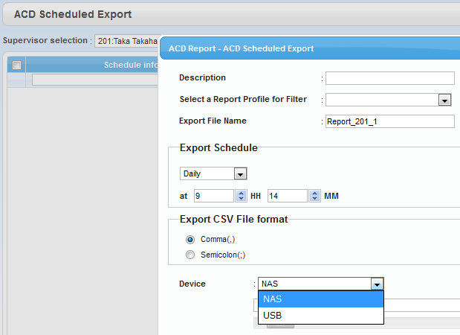
31. ACD Report by E-mail
AK
Required
Report can be e-mailed from PBX to e-mail address of ACD supervisor automatically.
CSV file is attached.
CSV for e-mail is same as report
by [View Report].
Export to : NAS / USB / E-mail
Both AK1 and AK2 are required for full report by e-mail. See chapter 2.
AK3 is not effective for e-mail feature.
AK1 : KX-NSF201 or KX-NSXF022 (ACD report)
AK2 : KX-NSXF023 (New AK for ACD Enhance)
AK3 : KX-NSXF202 (New AK for Charge report)

Slide 18
Chapter 4
Conditions of ACD Report

Slide 19
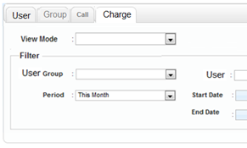
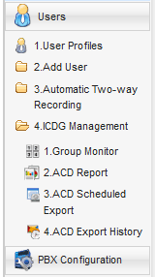
41. Other Improvement
Other improvements are as follows. <GUI>
- When Web-MC is Off line mode,
- Report with Zero data is available.
- Required AK is displayed.
for all reports.
This will be useful for demo without PBX.
- Even if required AK is not installed,
- Report with Zero data is available. (User & Charge reports)
- Required AK is displayed. (All reports)
- “Call Management” is displayed on menu instead of
“ICDG Management”.
KX-NSXF202 AK is required.

Slide 20
42. Conditions
Conditions are as follows.
(1) Extension to extension call is not recorded.
(2) Verification code is recorded instead of extension number when
verification code is used for outgoing call.
(3) When ICD group is UCD or priority hunt type, and call is not answered,
result is recorded for ICD group only. (Not recorded for extension)
*) Condition (3) is removed from KX-NS300/500/700 version 6.01
and KX-NS1000 version 6.01.
(4) Agent report is removed by default. User report is successor of Agent report.
Both User report and Agent report can be displayed by system reserved bit.
(5) Optional SD card is required for KX-NS300/500/700.
60-day trial is available for these AKs.
AK1 : KX-NSF201 or KX-NSXF022 (ACD report)
AK2 : KX-NSXF023 (New AK for ACD Enhance)
AK3 : KX-NSXF202 (New AK for Charge report)

Slide 21
Chapter 5
Remote Maintenance via KMS

Slide 22


51. Remote Maintenance via KMS
AK
Required
Remote Maintenance is available via KMS through internet without VPN, Port Fwd by router and so on.
KX-NSS101 AK is required.
This AK is not required for other remote connections.
Panasonic-Cloud (KMS)
Internet

Slide 23
Chapter 6
Push Notification for
KX-UCMA Mobile Softphone

Slide 24


61. Push Notification
KX-UCM AK
Required
Incoming call is informed using “Push Notification” in order to save battery life of smart phone. Application stops working during idle.
Application starts working again after receiving “Push Notification”.
GCM / APNS
Push Server
by Panasonic
(2) Token
(3) Push
Ext 102
(1) MPR ID +
SIP User Name
Internet
Mobile Softphone
(5) Start ringing
Ext 101
(4) SIP Connection
Panasonic
KX-NS PBX
(0) Make a call to 102.
GCM = Google Cloud Messaging
APNS = Apple Push Notification Server
KX-UCMA AK is required for KX-UCMA mobile softphone. (Not for PBX)
Notes:
24

Slide 25
62. Automatic Registration
KX-UCM AK
Required
Push notification is registered automatically.
Programming is NOT required for PBX.
(7) Token + OS Type
+ MPR ID
+ SIP User Name
GCM / APNS
Push Server
by Panasonic
(6) Token
KMS Registration
Server
by Panasonic
(5) Device
Registration
AK
(4) AK OK or Not
Internet
(3) MPR ID
Mobile Softphone
(2) MPR ID
(1) SIP Connection
(8) Push Setting
Panasonic
KX-NS PBX
GCM = Google Cloud Messaging
APNS = Apple Push Notification Server
Notes:
25

Slide 26
Chapter 7
SIP TLS

Slide 27
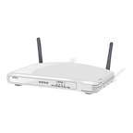




71. SIP TLS
AK
Not Required
SIP TLS supports secured communication for SIP protocol.
<Conditions for KX-NS1000>
Max. 128 SIP phone users can use SIP-TLS at the same time.
Other SIP phone users can use SIP (UDP).
Internet
Free Wi-Fi
by Hacker
Hacker cannot see SIP password and so on.
Notes:
27

Slide 28
Chapter 8
Built-in PMSi

Slide 29
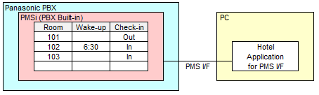
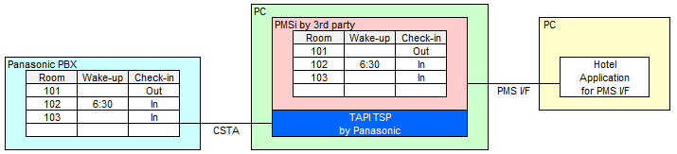
81. Built-in PMSi
AK
Required
Built-in PMSi is supported. Programming is not required.
AK : KX-NSF101 or KX-NSA020 is required.
One AK supports both CTI and built-in PMSi at the same time.
Call center
Application
Hotel
Application
One AK
Recently some local hotel applications are also using PMSi for 2 or 3 stars hotel.
These applications are popular now because web reservation is supported.
KX-NS older version needed 3rd party solution with server.
Notes:
29

Slide 30
Chapter 9
Other Technical Improvement

Slide 31
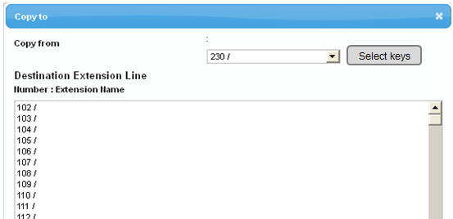
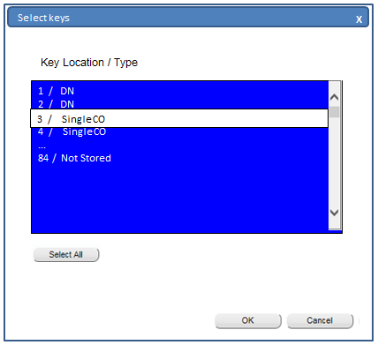
91. Selected Flexible Key Copy
AK
Not Required
Selected flexible keys (Not all flexible keys) can be copied to selected other extensions using Web-MC.
<Example>
Administrator programs CO buttons and Paging button for flexible key 1 to 12.
Each extension users program one touch dialing for flexible key 13 to 24.
=> Administrator wants to copy flexible key 1 to 12 only.
Notes:
31

Slide 32
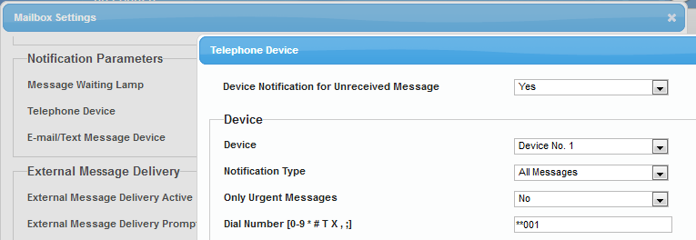
92. Disable call from VM to Trunk
AK
Not Required
Call from VM to Trunk is disabled for any VM features.
TRS level 7 is applied for VM except system speed dialing.
VM means followings.
- built-in UM except fax server
- VM (DPT) group
- VM (DTMF) group
International
and so on
Speed dial code (**XXX) or extension number is recommended.
Basically it is recommended for VM to email to smartphone instead of calling from VM to smartphone / cellular phone, when message is left into mail box or other features.
<Risk of Calling from VM to Trunk>
1. Hacker calls PBX.
2. VM Mailbox answers the call when extension does not answer.
3. Hacker dials [#][6][*] + Mailbox number and password.
(Some mailbox users are using quite simple password.)
4. Hacker can program notification feature.
PSTN
PBX
UM
TRS level 7 has to be programmed for VM extension, if KX-NS is version 5 or older version.
Notes:
32

Slide 33
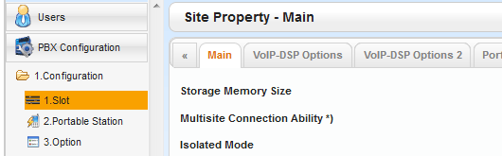
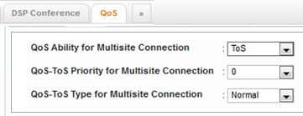
93. QoS
AK
Not Required
QoS is supported for one-look network and IP extension.
<QoS for one-look network>
Parameter for QoS is assigned in KX-NS1000 master PBX for communication with each slave PBXs.
Communication between PBXs | Parameter
Master PBX to Slave PBX (Site 2) | Parameter for Site 2 is applied.
Slave PBX (Site 2) to Master PBX
Master PBX to Slave PBX (Site 3) | Parameter for Site 3 is applied.
Slave PBX (Site 3) to Master PBX
:
Master PBX to Slave PBX (Site 16) | Parameter for Site 16 is applied.
Slave PBX (Site 16) to Master PBX
When slave PBX is KX-NS300-500-700 version 6.00, QoS is applied for communication from KX-NS1000 master PBX to slave PBX only. QoS is NOT applied for communication from slave PBX to KX-NS1000 master PBX.
So KX-NS300-500-700 should be version 6.01.
Notes:
33

Slide 34
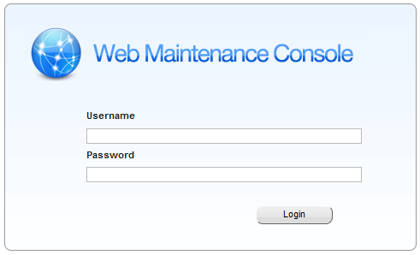
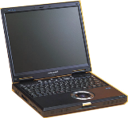

94. Stronger Security for Web-MC
AK
Not Required
Remote Maintenance using LAN port by Port Fwd or using WAN port is restricted for stronger security.
<Exception>
The exception is when the Web-MC password satisfies
all of the following four conditions.
- It contains three different letters from A to Z.
- It contains three different letters from a to z.
- It contains two different letters from 0 to 9.
- It does not contain “ABC” or “abc” or “1234”.
Exception is applied for User, Admin and Installer level.
Connection from the internet is not allowed.
Internet
LAN port
Internet
WAN port
Port Fwd by router to PBX
Connection from same network is not restricted regardless of password level.
Remote maintenance via KMS, VPN and so on are not restricted.
Remote maintenance via KMS is strongly recommended .
Hacker

Slide 35
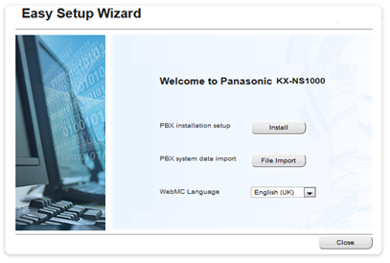
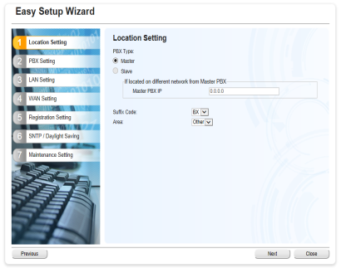
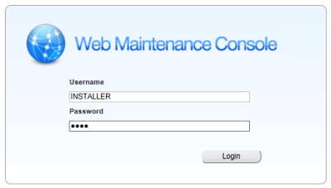
95. Data transfer by Easy setup
AK
Not Required
System data can be transferred by Easy setup.
(1) Panasonic in each area prepares several samples of system data
with dialing plan, SIP trunk data (except ID and password) and so on.
(2) Installers can transfer one of the sample system data when PBX is installed.
Long steps..
Select file only !!

Slide 36
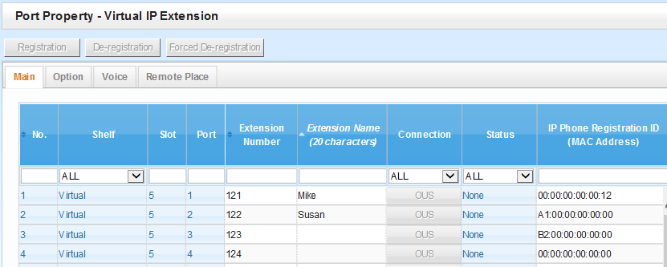

96. CSV for KX-NT registration
AK
Not Required
CSV file export / import is available for KX-NT registration data.
Extension number, name and MAC address
- KX-NT phone can be registered easily before unpacking.
- KX-NT phone can be replaced from KX-NS300/500/700 to KX-NS1000
easily.
CSV

Slide 37
Thank you !

