Slide 1
Samsung OfficeServ
Conference Solution
October 2010
Samsung Electronics Co., Ltd.

Slide 2
Contents
Samsung OfficeServ Conference Solution
  Samsung Conference Solution
  Samsung OfficeServ Meet-me Conference Card
  Simple, Easy & Intuitive Conferencing
  Cost-effective Conference Solution
  For SMBs Who
Conference Features in Detail
  Host Meet-me Conference
  Join Meet-me Conference
  During Meet-me Conference
  Meet-me Conference Recording
  Meet-me Conference Paging
  Personal Web Page
Product Specification
  S/W H/W Specification
  Slot Location

Slide 3
Samsung Officeserv conference solution

Slide 4


Samsung Conference Solution
Samsung Conference Solution delivers productive communication and collaboration to businesses, from SMB to Enterprise, voice to video conference, and IP video phone to soft PC client.
50
100
3,000
Samsung OfficeServ Conference
Samsung Communication Manager Conference
In-skin card type conference
Supports 24 simultaneous calls
5 types of Conferencing
Meet-me
Pre-defined
Adhoc
Meet-me + Adhoc
Meet-me + Paging
OfficeServ 7200, 7400
Server-embedded type conference
Supports 128 simultaneous calls
6 types of Conferencing
Meet-me
Pre-defined
Adhoc
Meet-me + Adhoc
Meet-me + Paging
Progressive
SCM Express edition
Unified Communications Clients – PC Communicator
Enterprise UC Client
Integrated Communication and Collaboration
Microsoft Office Outlook Sync
Samsung UC IP Phone Sync
Conferencing Features
Multi-chatting
Video Call, Video Conferencing up to 5 members
Whiteboarding, File Transferring, Display Sharing

Slide 5
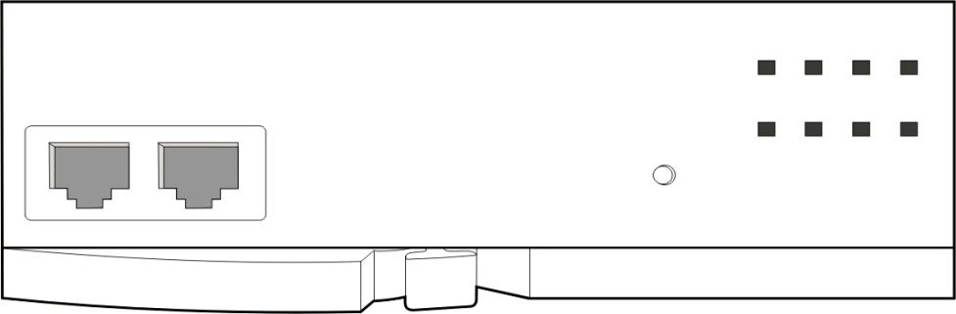

Samsung OfficeServ Conference Bridge
The NEW Samsung OfficeServ Conference bridge card (CNF24) provides small and medium businesses a simple, easy and intuitive in-house conferencing as well as huge investment protection.
SMB-Optimized Communication & Collaboration Conference Solution
“
Samsung Conference Solution enables SMBs
truly effective collaboration
Supporting 24 simultaneous conference call
Web-based personal page → easy & simple conference management including set up to recording
Recording & Paging
Outstanding voice conference quality
Hugh Investment Protection
”
RUN
LAN
SVC
MC
RST
CONF
REC
MEM
BACKUP
LAN
SIO
CNF24

Slide 6
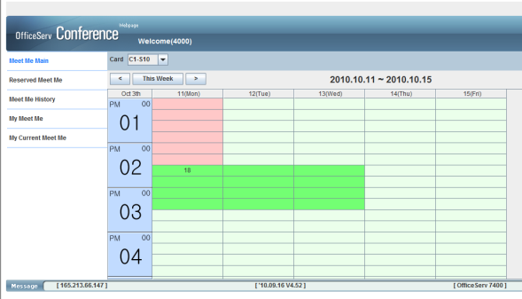
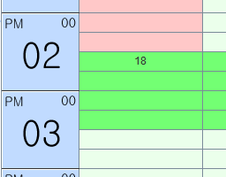
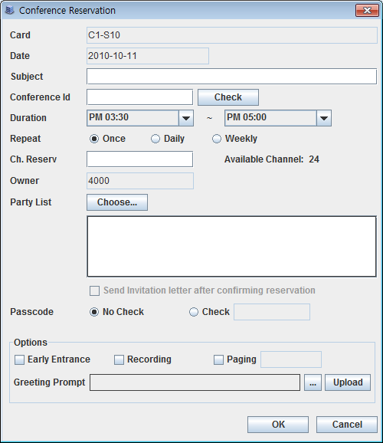
Simple, Easy & Intuitive Conferencing
Anybody can access, create and organize conference using standard web page with Samsung Conference bridge. Personal Web Page’s intuitive GUI makes organizer invite internal and external colleagues easily.
“
Intuitive Graphic User Interface
”
Calendar shows conference schedule intuitively by colors
15 minutes, 24 hours, 7 days
Easy set up – just drag and click!
“
User-Centric Experience
”
Number of channels available is displayed when you put mouse cursor
Support 24 simultaneous conference channels for 1 card
It is all about user!
“
Simple & Easy Conference Set Up
”
Just set a few things which are inevitable to conference – i.e. number of attendees, whether you are using paging, recording or not then conference channel is created!
Attendees receives invitation message via e-mail

Slide 7

Cost-effective Conference Solution
Samsung OfficeServ Conference Solution protects SMB’s investment on in-house conference solution through simple, light but powerful conference features without redundancy.
“ Cost-Saving Embedded Recording
“ Remarkable Voice Quality
”
”
Maximum 50 hours recording in G.711
Play & Download recorded file
No outside recording server required
No redundancy happens
Using VoIP chipset with DSP technology, Samsung OfficeServ conference solution delivers more natural communication and free-flow conference
Complete high-value VoIP media and control processing between narrowband TDM and Ethernet, allowing inexpensive POTS termination systems to be built on an Ethernet / LAN-based architecture
  Echo cancellation
  Tone detection
  POTS-focused features
Samsung OfficeServ Conference Solution enables more productive conference!

Slide 8

For SMBs Who…
Samsung OfficeServ Conference bridge solution designed to meet every SMB’s different needs
Want to maximize collaboration between employees
Already deployed OfficeServ series and want to deploy meet-me conference features
Need quick decision making
Want to protect investment on Conference from outside vendors
Have several local offices
Expect Return-on-Investment (ROI) maximization
And so on…

Slide 9
Conference features in detail

Slide 10
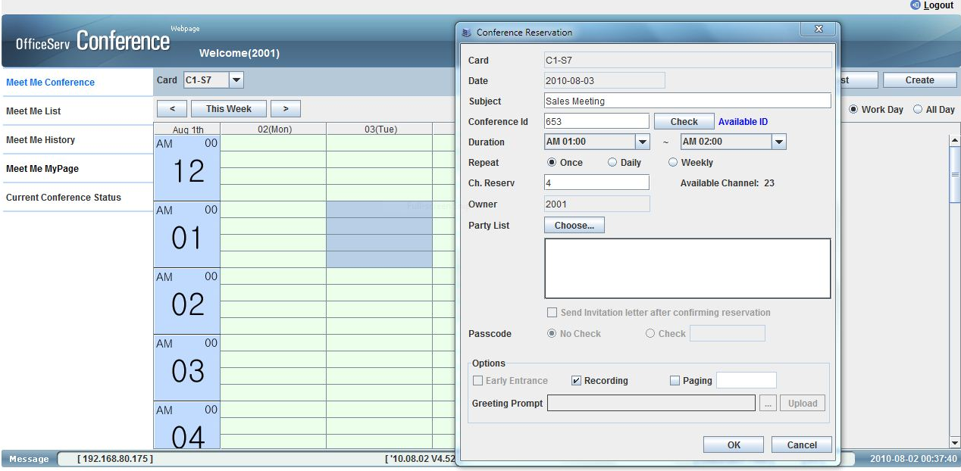

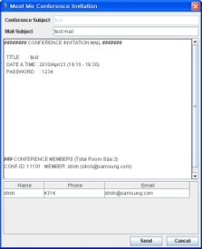

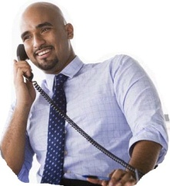
Host Meet-me Conference
Users who want to create Meet-me Conference can easily preside over a meeting via Meet-me main page. Just dragging and clicking will create your conference. After inputting all details of your conference, system will send your members invitation emails which contains conference title, date & time and password. They will help remind your conference to your members.
I can easily create Meet-me conference thanks to Samsung Conference Solution ☺
1. Drag it as much as you want. Then click the create button.
2. If another page pops up, put the details into that.
3. After finishing, send the invitation
mails to your members.
We’ve got mails !

Slide 11



Join Meet-me Conference
If you get the invitation mails, please enter the addresses and pass word that creator have already made.
After entering addresses and password, Then, say a word that identifies you. You can hear the SPA sound that welcomes you.Recorded Voice with your language and good music will guide you to the Meet-me conference.
 | USA | KOREA | UK
1. Dial Meet-me Feature key or code
2. Dial conference ID & Password
3. Greeting
4. Record ‘whoamI’
5. Play SPA
6. Join Alarm
If I get the invitation mail
All I have to do is just entering an address and password and identifying me.

Slide 12



During Meet-me Conference
During a Meet-me conference, you will have a variety of situations and Samsung’s variety of functions can help you to handle those of problems.
Item | Description
Extend Time | Extend the time of conference for 15 minutes. User can extend the time up to 01:00
Lock | Lock the conference
Action (Kick Out/ Clear/ Mute) | - Kick Out: Kick out the selected member Clear: Clear the channel status for new member - Mute: Mute the selected member
Recording Start /Recording Stop | Record/stop the voice of conference Recording button can be activated when recording option is selected on reservation menu.
Paging Start /Paging Stop | Page/stop all members Paging button can be activated when paging option is selected on reservation menu.
Terminate | Terminate conference
Sometime I face lots of situations during a meeting. Samsung Conference Solution enables me to control those of things easily. ☺

Slide 13
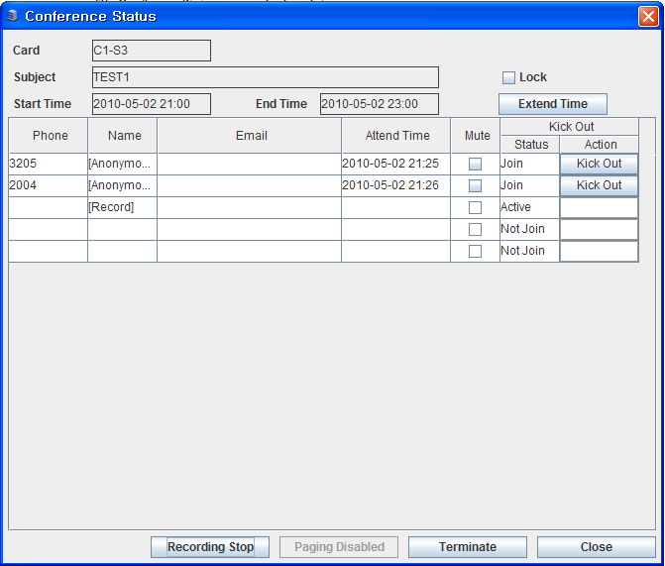
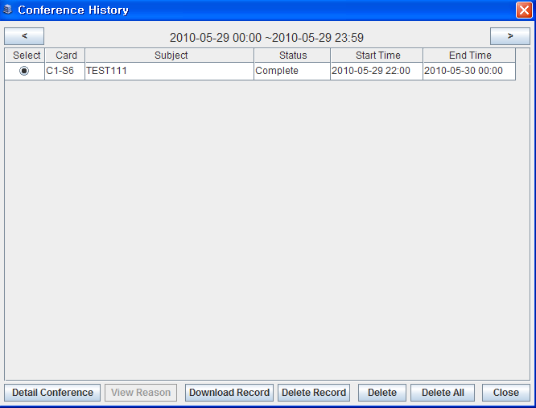
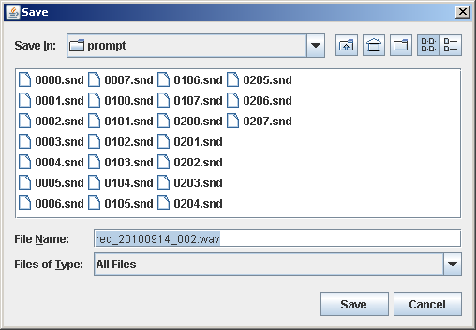
Meet-me Conference Recording
Master can record current conference which sets Recording option to enable. After completing or terminating conference, master can download and play recorded conference file. Please be sure that one recording occupies one conference channel
Record Meet-Me Conference
1. Connect Conference Webpage and click [My Meet Me] menu
2. Information of all conference groups is displayed. Select one conference group that you
want to record and click [Watch] button
3. Conference Status menu is displayed. Click [Recording Start] button to start recording
conference call.
Download Recorded Conference
1. Connect Conference Webpage and click [Meet Me History] menu
2. Information of all completed or terminated conference groups is displayed.
Select one conference group that you want to download recorded conference file and
click [Download Record] button. Be sure that [Download Record] button is activated
only when selected conference is completed or terminated.
Save and play recorded conference
1. When save menu is displayed, Select directory and save current recorded file.
2. Run a multimedia program and open a downloaded conference file.
The downloaded conference file is provided by wave type, so you don’t have to
change its file type.

Slide 14
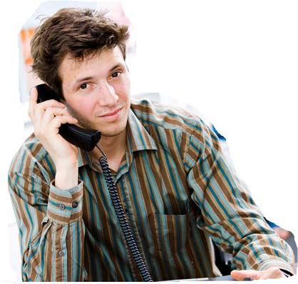
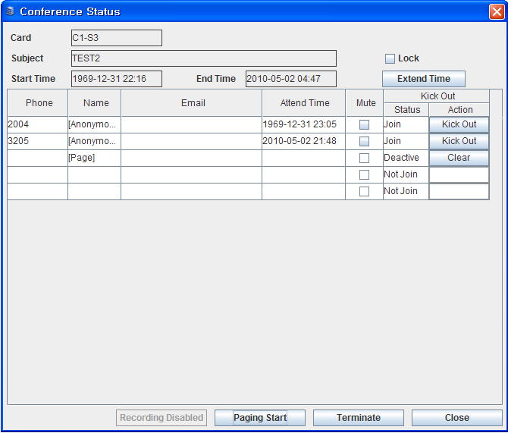

Meet-me Conference Paging
Sometime some of members cannot attend the meeting due to many reasons. Samsung CNF24 can help them to work seamlessly by paging the conference. Please be sure that one paging occupies one conference channel.
I can listen to the conference proceedings although I can not attend it. ☺
Page Meet-Me Conference
Before connecting Conference Webpage, page group (0~4) and its members
should be set in DM 4.1.3.
1. Connect Conference Webpage and click [My Meet Me] menu.
2. Information of all conference groups is displayed.
Select one conference group that you want to page and click [Watch] button.
3.Conference Status menu is displayed.
Click [Paging Start] button to start paging conference call.
Page members can hear current conference until page is stopped.

Slide 15
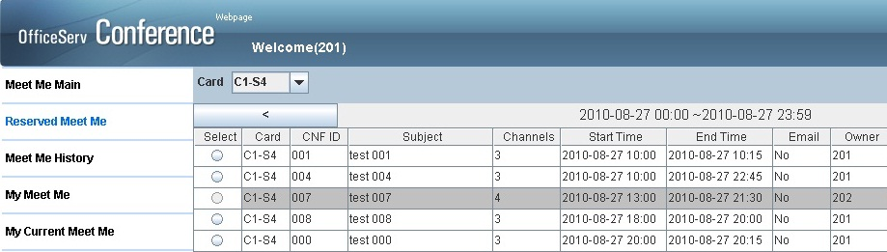
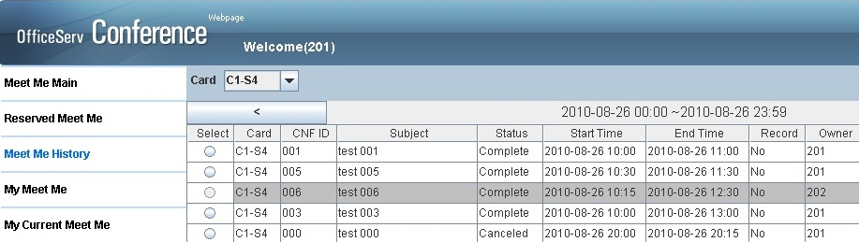
Personal Web Page
Here is the web page called PWP(Personal Web page) that controls your various conference situations
Through PWP, you can create and check the conferences, conferences that you have booked and conference in progress.
Reserved Meet Me
You can see the reserved conference and cancel the conference that you want to.
Meet Me History
In this page, you can see the
conference history and
delete it
Notes:
My Meet-me Conference 통해서 History 관리
Conference web page
[My Meet Me]→ [Watch]

Slide 16
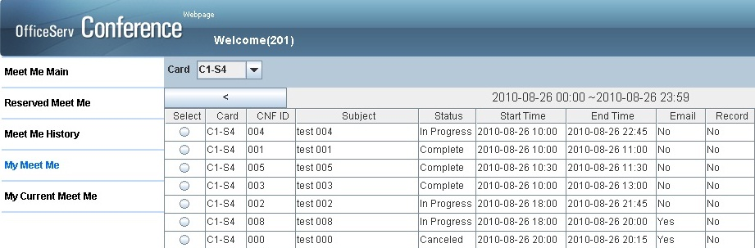
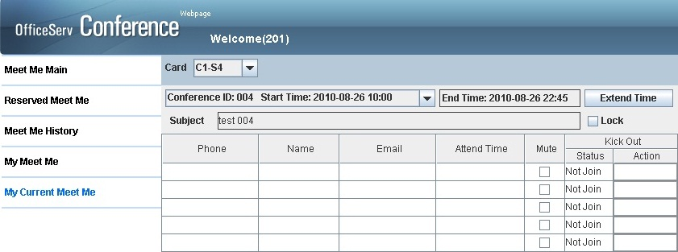
Personal Web Page
Here is the web page called PWP(Personal Web page) that controls your various conference situations
Through PWP, you can create and check the conferences, conferences that you have booked and conference in progress.
My Meet Me
If click this menu, you can see your conference reserved list/history/in progress for login user.
My Current Meet Me
You can see your conference
in progress. There are some
features that help you for
seamless conference
proceeding including Mute or
Kick-out etc.
Notes:
My Meet-me Conference 통해서 History 관리
Conference web page
[My Meet Me]→ [Watch]

Slide 17
Product specification

Slide 18
H/W S/W Specification
Max Users | 1 Card (MP20S) | 24 members, 1 groups
 | 2 Cards (MP20) | 24 members, 2 groups
 | 4 Cards (MP40) | 24 members, 4 groups
Audio | Codec | G.711, G.729, G.723
 | Recording | G.711 (max 50 hours)
 | Trunk | Digital Trunk, SIP Trunk
H/W | CPU | M82356 chipset
 | NAND Flash | 2GB
 | Ethernet | 10/100/1000
 | SDRAM | 128MB
 | Boot ROM | 512KB
Conference Features | Web-based Managegment | Configuration, Monitoring, Statistics
 | Reporting | Conference List Status Conference List Statistics
 | Customizing Greeting | Recording Greeting messages, File Upload
 | E-mail Integration | Yes
No. of Conferences per card | No. of users per Conf. | No. of Users if recording | Recording Channels used
1 | 24 | 23 | 1
2 | 12 | 10 | 2
3 | 8 | 7 | 3
4 | 6 | 5 | 4
6 | 4 | 3 | 6
8 | 3 | 2 | 6 (max no.)
12 | 2 | N/A | N/A

Slide 19



Slot Location
OS7400
      Max 4 cards per system
      96 ports Max
OS7200
      Max 2 cards per system
      48 Ports Max
OS7200S
  Max 1 card per system
  24 Ports Max

Slide 20
Thank You!

