Slide 1
Distribution
Ver.1.0
English
SCM Compact V2.4.0 Configuration Guide

Slide 2
History
Version | Date | Changes
1.0 | 2019.01 | Initial version for V2.4.0.x
Notes:
Note

Slide 3
| [Intercom2] One Way Mode
| [Intercom2] Forced Disconnect
※ This function was tested in SMT-I 5343 T04.10
| ACD Call Pickup
| SBC] Request URI Change
Notes:
3

Slide 4
[Intercom2] One Way Mode

Slide 5
[Intercom2] One Way Mode
The One Way Mode for Intercom (receiver) is set to ‘One Way Mode’ in the [CONFIGURATION > Service > User Service > Intercom] menu.
※ The callee of intercom answer the call automatically and can only hear as the MUTE key turns on.
Notes:
Note

Slide 6
[Intercom2] Forced Disconnect

Slide 7
[Intercom2] Forced Disconnect
The ‘Forced Disconnect’ mode for Intercom Extension Number is set to ‘Forced Disconnect’ in the [CONFIGURATION > Service > User Service > Intercom] menu.
This feature applies only to the using for intercom KEY of Phone Key Programming.
If there is an intercom call in the conversation state when new intercom KEY is pressed, the existing intercom call ends and new intercom call proceeds.
※ This is valid only when the existing intercom call generated through KEY and is not applicable to manual operation.
Notes:
Note

Slide 8
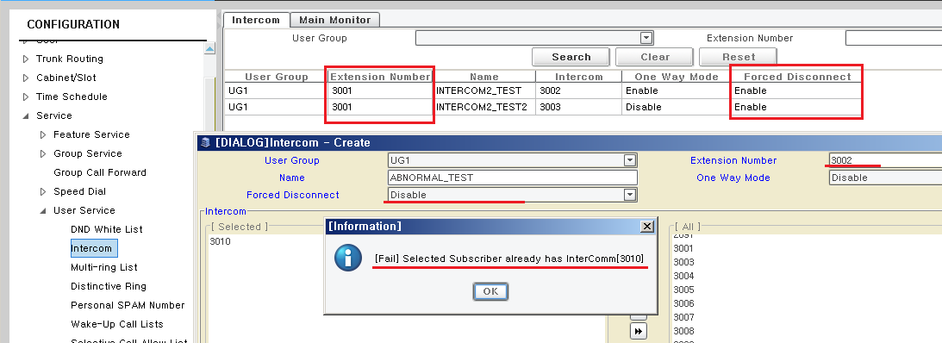
[Intercom2] Forced Disconnect
Your can not set different ‘Forced Disconnect’ value on one Extension Number.
If you try to set different value on same Extension Number, It will be failed with pop-up information in Admin.
Notes:
Note

Slide 9
ACD Call Pickup

Slide 10
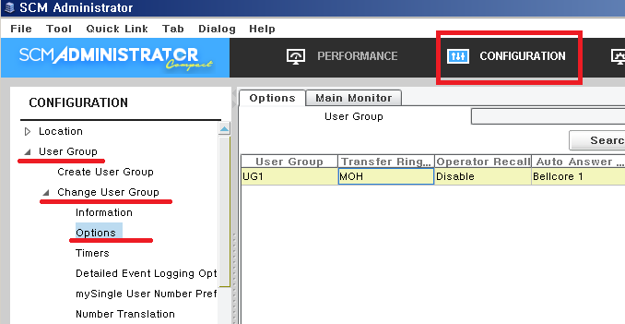
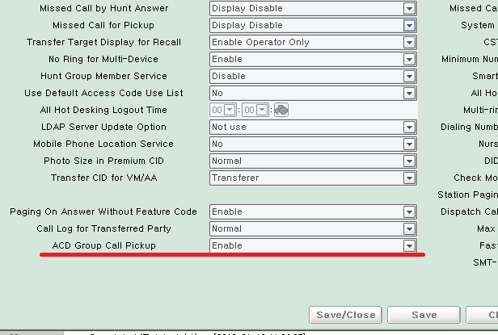
ACD Call Pickup
To pickup ACD Group Call, ‘ACD Group Call Picku’ is set to ‘Enable’ in the [CONFIGURATION > User Group > Change User Group > Options] menu.
Notes:
Note

Slide 11
[SBC] Request URI Change

Slide 12
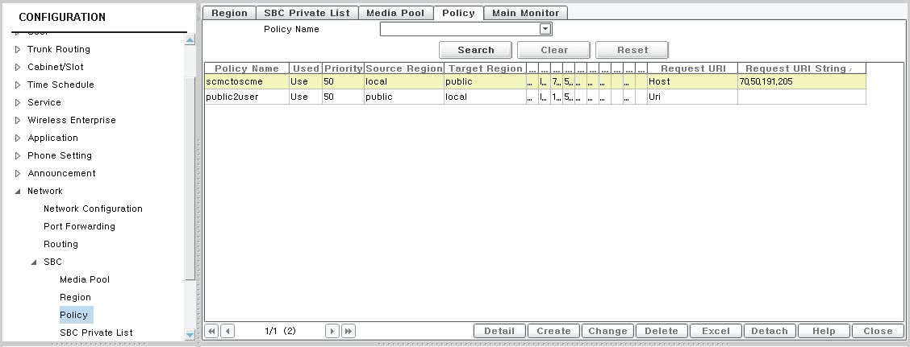
[SBC] Request URI 변경
The Request URI Change function is set to ‘Request URI’ and ‘Request URI String’ in the [CONFIGURATION > Network > SBC > Policy] menu.
Notes:
Note

Slide 13
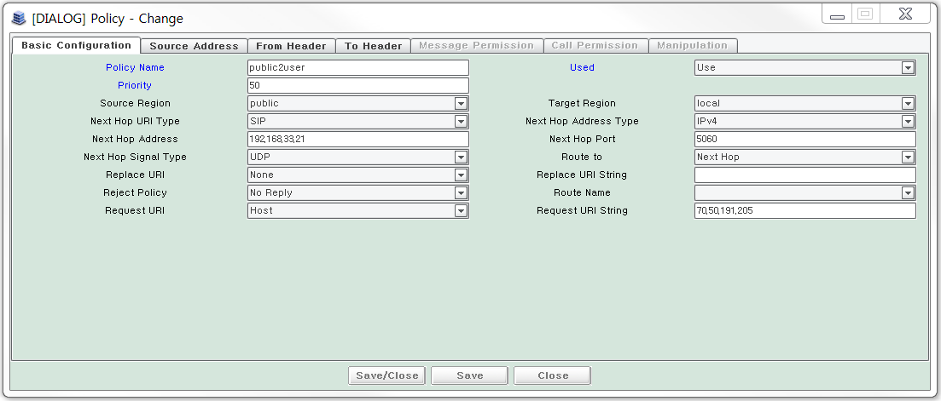
[SBC] Request URI 변경
The Operator can change Request URI information for Host or User Info.
in the [CONFIGURATION > Network > SBC > Policy] menu.
Notes:
Note

Slide 14
End of document

