Slide 1
How to Upgrade IP Phone
(From SPP to SCME package)
Notes:
1

Slide 2
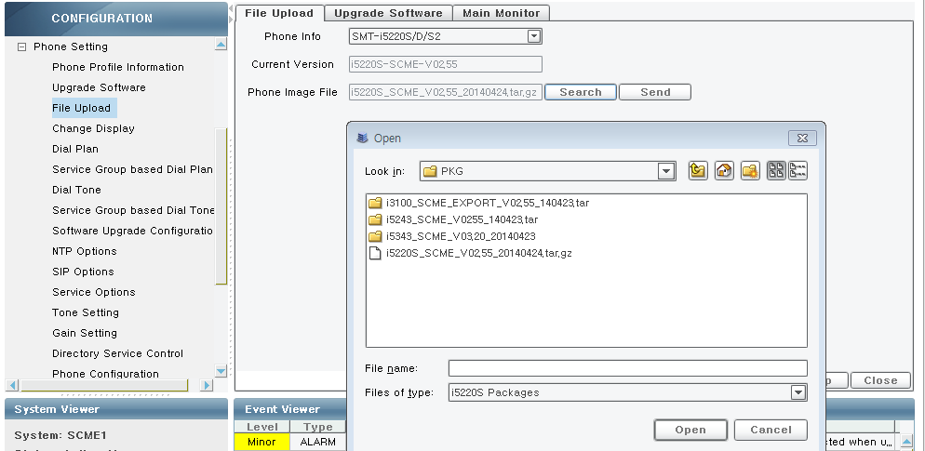
Move to PKG (SCME)
Prepare the new SCME IP phone package and Upload package to SCME System by SCME Admin.
CONFIGURATION → Phone Setting → File Upload
Notes:
When you need upgrading SIP phone software, follow by these steps.
1) Preparing Software
First of all, you should copy phone software image file to your local PC.
2) Uploading Package
You can upload the phone software image file using [CONFIGURATION > Phone Setting > File Upload] menu.

Slide 3
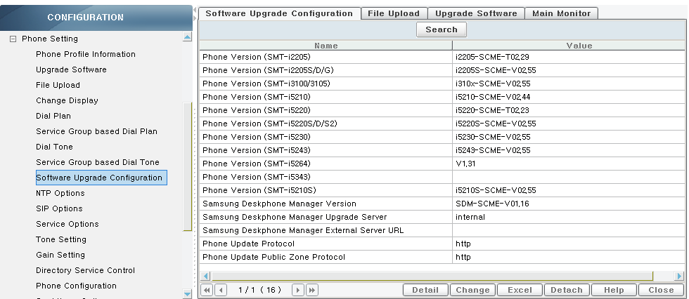
Check Phone Version
Input the current software version value
CONFIGURATION → Phone Setting → Software Upgrade Configuration
example)

Slide 4
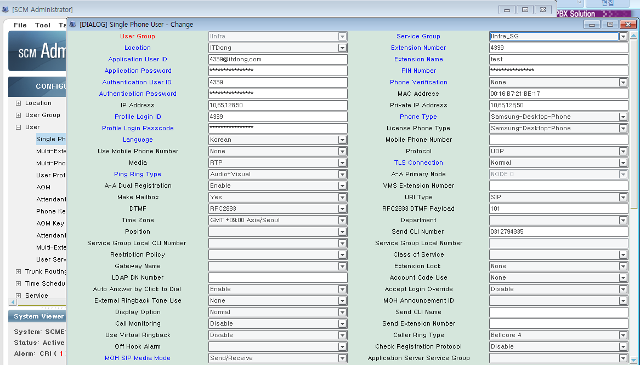
Phone SW Upgrade
upgrade the new IP phone software.
- Static IP or DHCP Mode
1. Go to Engineering Mode
2. Select Easy install Mode
3. Setting Network Mode, Server IP, User ID, Password and Reboot,
then Phone is upgrade from SPP PKG to SCME PKG through SCME System
( Request upgrade file to SCME -> Upgrade SCME PKG)
※ User ID is Profile Login ID, Password is Profile Login Passcode.
Notes:
When you need upgrading SIP phone software, follow by these steps.
1) Preparing Software
First of all, you should copy phone software image file to your local PC.
2) Uploading Package
You can upload the phone software image file using [CONFIGURATION > Phone Setting > File Upload] menu.

Slide 5
Phone SW Upgrade
upgrade the new IP phone software.
- PNP Mode
Set Network Configuration( need to DHCP Server)
- Set some DHCP Option Field in DHCP Server.
(66: TFTP_Server_Name = SEC_ITP 128: TFTP Server IP Addr.= x.x.x.x
43 : Vender specific Info = sec, tftp://x.x.x.x)
※ x.x.x.x is SCME System IP address
Power on the IP Phone.
- Phone will obtain Phone IP and SCME System IP from DHCP Server.
Phone will be upgrade from SPP PKG to SCME PKG through SCME System.
After restart phone, phone will be registered to SCME System by PNP Mode.
refer to next page for detail information.
Notes:
When you need upgrading SIP phone software, follow by these steps.
1) Preparing Software
First of all, you should copy phone software image file to your local PC.
2) Uploading Package
You can upload the phone software image file using [CONFIGURATION > Phone Setting > File Upload] menu.

Slide 6
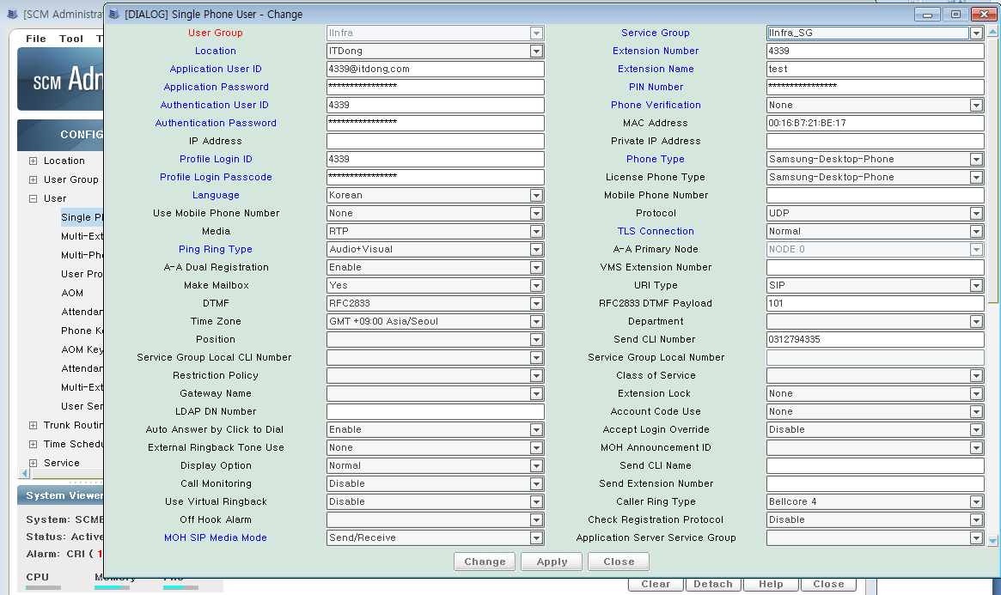
Make MAC Profile(in SCME System)
Input the phone MAC Address
CONFIGURATION → User → Single Phone User
example)
※ For ‘PNP’ mode Connection with SCME System, need to MAC profile in SCME System. If input MAC Address in Single Phone User menu, then MAC Profile was generated in SCME System.

Slide 7
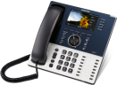
Upgrade PKG(In PNP Mode)
DHCP Options(for PNP Mode)
DHCP Discover
60: Class Identifier = SEC_ITP
DHCP Offer
43: Vendor specific Info. = sec …
66: TFTP_Server_Name = SEC_ITP
128: TFTP Server IP Addr.= x.x.x.x
DHCP Request
60: Class Identifier = SEC_ITP
DHCP ServerV2
DHCP Ack
43: Vendor specific Info. = sec …
66: TFTP_Server_Name = SEC_ITP
128: TFTP Server IP Addr.= x.x.x.x
IP Phone
Option 128. TFTP Server IP Address
Example)
TFTP Server IP Addr. = 1.2.3.4
※ 1.2.3.4 is SCME System IP Address
Option 43. Vendor Specific Information
Example)
Vender specific Info = sec, tftp://1.2.3.4
※ 1.2.3.4 is SCME IP Address

Slide 8
Notes:
8

