Slide 1
OfficeServ
System Logs
&
MP Trace
2015/7/10
by SeungTae,Roh

Slide 2
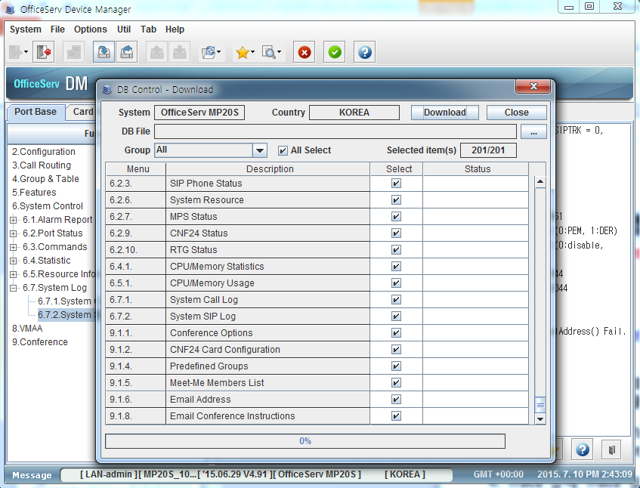
System Logs
When a problem Occurs > Download the System Database
Send the System DB to HQ
- Beginning with V4.91, the log information is included in the System DB. When you save the system DB you also save the System Logs.
> 6.7.1 System Call Log
> 6.7.2. System SIP Log
- Capacity : most recent 450 calls (approximately)
- Caution : This information does not remain when the system is restarted
Procedures
1. Connect to the system at the time the problem
  occurred by using DM v4.92
2. In the top menu bar, click System> Download DB menu
3. Select all entries
4. Click the […] button to create a DB File
5. Click the [Download] button to download a System DB

Slide 3
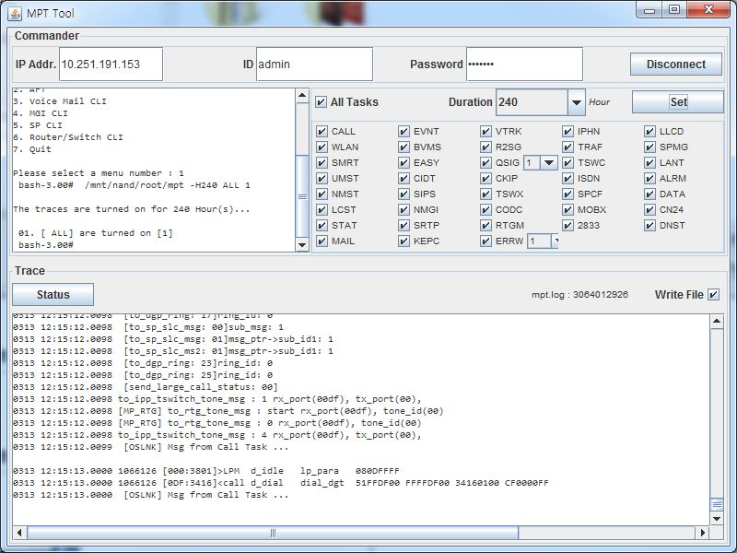
MPT Tool – Trace Log
When a problem Occurs
Send the detail MP Trace Log to HQ
- Beginning with V4.91, the MP Trace log can be collected from a remote system MP
> MP Task Trace Log
- Port Usage : HTTP(80), TELNET(23), TRACE(5030)
Procedures
1. In DM 5.13.11. Management IP White List menu, input the IP address of PC to use MPT Tool
2. In Web Browser, input MPT Tool URL
[OS7100,OS7030,OS7070,MP20s] http://system_ip/mptTool.php
[OS7400, MP20 – Private IP] http://system_ip/card/mptTool.jnlp
[OS7400, MP20 – Public IP] http://system_ip/card/mptTool_public.jnlp
3. In MPT Tool, input the PW (default Telnet password)
    [OS7100,OS7030,OS7070,MP20s] Inputted User ID: admin
    [OS7400, MP20] Inputted User ID: kpsw
4. After select Trace Task and Duration, click the [Set] button
5. Click the [Write File] button to start saving a Trace Log on your PC
6. Select path then and enter a file name
7. After reproducing the problem > Click the [Write File] button to finish saving the file

Slide 4
MP Trace Tool - Use Case
- Basically, always check ‘CALL’ and ‘EVNT’.
- In case of problem related to SIP Trunk or SIP Phone, check ‘SIPS’.
- In case of problem related to signaling of SIP Trunk or SIP Phone, check ‘VTRK’.
- In case of problem related to ISDN, check ‘ISDN’.
- In case of problem related to SPNET , set ‘QSIG’ to 1 and check ‘ISDN’.
- In case of problem related to OSPP IP Phone, check “IPHN’.
- In case of problem related to T.38 Fax, check ‘2833’.
- In case of problem related to voice path, check ‘TSWC’ and ‘NMGI’.
- In case of problem related to sRTP, check ‘SRTP’.
- In case of problem related to Mobex, check ‘MOBX’.
- If R&D request a use of other options , please check it.

Slide 5
Problems when Launching
MP Trace Tool application

Slide 6
Trouble Shooting Tips
When you can not download the MPT Tool application
  [Control Panel >Java >General >Temporary Files >Settings…]
    Uncheck “Keep temporary files on my computer”
    In [Delete Files…], After check “Installed Applications and Applets” , click the [OK] button
  In [Control Panel >Java >General > Network Settings…], select a option according to network configuration
When web page has the problem
  In Internet Explorer, click [Tool >Compatibility View Settings]
  Add the system IP address

