Slide 1


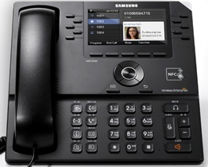
OfficeServ system Programming guide
for SMT-i5343
ED 1.0 (2014.06.09)

Slide 2



Ⅰ
Network configuration
Ⅱ
OfficeServ System Programming
Ⅲ
SMT-i5343 Installation
Ⅳ
SDM Features

Slide 3
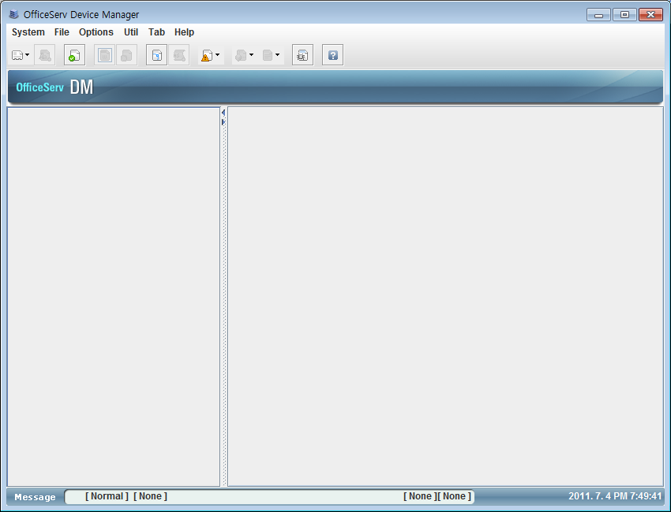
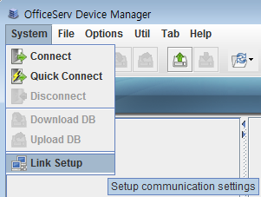
1. Network Configuration
– DM Connection
1) Run DM on your PC.
How to connect OfficeServ system through ‘OfficeServ DM(Device Manger)’.
1) Standalone mode
- Execute “osdm.exe” file .
2) Web browser mode
 | V4.60↑
 | Private network | Public network
MP20 MP40 | http(s)://System IP/dm/ | http(s)://System IP http(s)://System IP/dmp/ http(s)://System IP/dm_public/
MP20s OS7100 OS7070 OS7030 | http(s)://System IP
2) Select System -> Link Setup.
osdm files need to be uploaded to the DM directory in a SD card. But in case of OS7070, all files are already included.
MP40/MP20 : osdm.jar, osdmhelp.jar, osdm.jnlp, osdm_public.jnlp
MP20s/MP10a/MP11/7030 : osdm.jar, osdmhelp.jar
- Java6 is required for a normal operation of DM(V4.60 ↑)

Slide 4
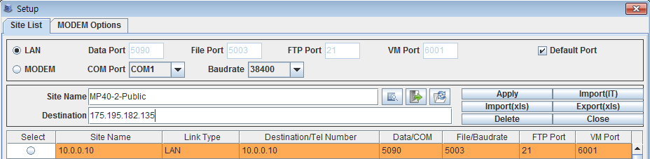
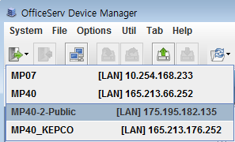
1. Network Configuration
– DM Connection
3) You can make the connection list as below.
- Enter the ‘Site name’ and ‘Destination IP address’. After then click “Apply” button.
4) Choose the site in the list for the DM connection.

Slide 5
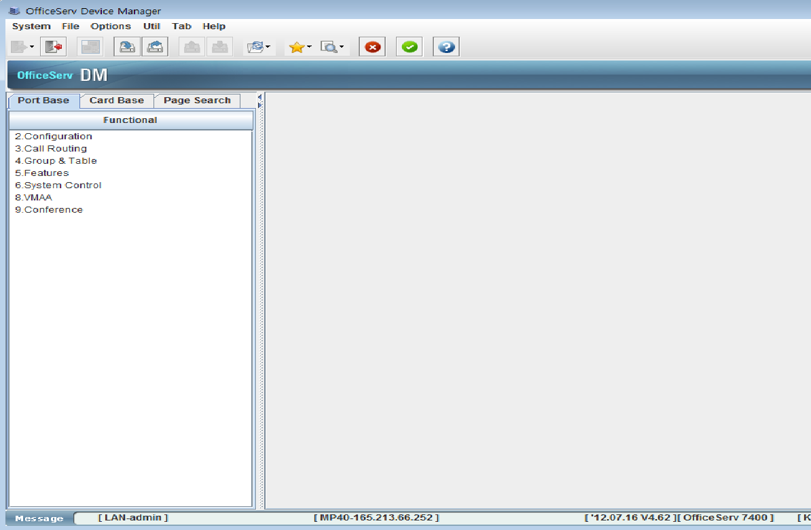
1. Network Configuration
– DM Connection
5) After entering a password, OfficeServ DM screen will be shown as below.

Slide 6
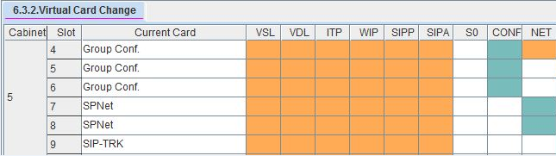
2. OfficeServ system programming
– Basic considerations for SMT-i5343
1) OfficeServ7000 Configuration
- Basically, how to use SMT-I5343 with OfficeServ7000 is same as other SMT series phones.
- To use SMT-i5343 with OfficeServ7000, OfficeServ700’s version should be V4.80 or over
2) Call MOVE feature
- SMT-i5343’s call MOVE feature is based on WE VoIP’s call MOVE feature including MOBEX.
- To use the various PBX features of WE VoIP client, SIP & ISDN trunk are recommended
- For ‘Call MOVE’ feature, one or more ‘Group Conf cabinet’ should be assigned in DM 6.3.2 ‘Virtual Card Change’ option.
- You should understand WE VoIP’s call MOVE feature before using SMT-i5343.
Please refer to ‘OfficeServ system Programming guide for WE VoIP’ for more details.

Slide 7


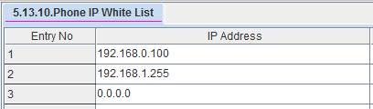
2. OfficeServ system programming
– SMT-i5343 &WE VoIP Registration
1) Enter the User ID and Password in DM 2.7.1 (MMC840) & DM 2.7.2 (MMC842)
2) Enter SMT-i5343 & WE VoIP IP Address in DM 5.13.10 (MMC875)

Slide 8
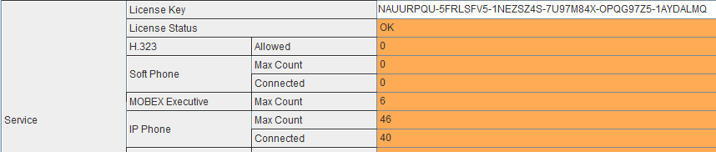
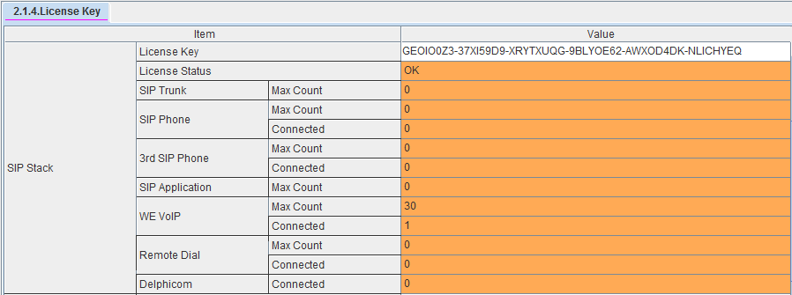
2. OfficeServ system programming
– License key
■ To use the SMT-i5343, enter a license key to DM 2.1.4 (MMC860) as below.
■ To use the WE VoIP client service, enter a license key to DM 2.1.4 (MMC860) as below.
- No SIP phone license is required.

Slide 9

2. OfficeServ system programming
– Station Pair : Multi-ring
■ Multi-ring service
In DM 4.2.1 ‘Station Pair’ option, make WE VoIP client paired with a SMT-i5343 phone.
- When user receives an incoming call on a paired SMT-i5343 phone(or WE VoIP), a missed call will not happen on the WE VoIP(or SMT-i5343).
- Setting or clearing CFWD or DND options will be applied to both paired devices.
■ Programming
1) In DM 4.2.1 ‘Station Pair’ option, make WE VoIP client paired with a SMT-i5343

Slide 10
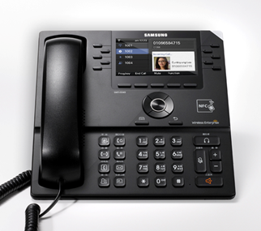
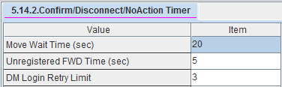
2. OfficeServ system programming
– Call Move
■ Seamless call move between a SMT-i5343 and WE VoIP client by fixed “Call Move” button.
- SMT-i5343→ WE VoIP
When a user selects ‘MOVE’ button on a SMT-i5343, WE VoIP client will be ringing. After then a user answers the call on WE VoIP client, the call in progress on the desk phone will be automatically disconnected.
- WE VoIP → SMT-i5343
When a user selects ‘MOVE’ key on a SMT-i5343, WE VoIP client will be disconnected from the call in progress and it will be moved to the desk phone with no ringing.
■ Programming
1) In DM 4.2.1 ‘Station Pair’ option, make WE VoIP client paired with a SMT-i5343
2) In DM 5.14.2, set the ‘Move Wait Time’ (Default : 20secs)

Slide 11
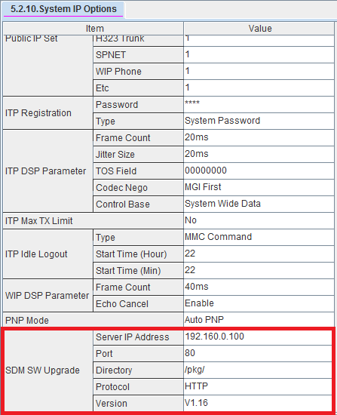
2. OfficeServ system programming
– SDM SW Upgrade
■ Programming
1) Set up Upgrade Server for HTTP or HTTPS and save SDM package file to the Server
2) In DM 5.2.10 ‘System IP Options’ option, Input SDM SW Upgrade’s options for the Upgrade Server.
3) When SDM disconnects and re-connects to SMT-i5343, You can see pop-up menu for new PKG upgrade and select upgrade it or not.

Slide 12
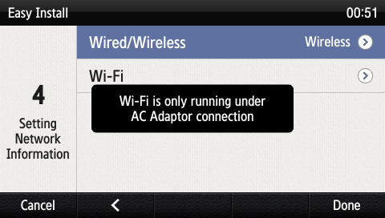
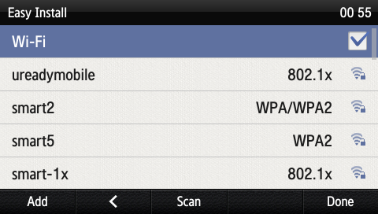
3. SMT-i5343 Installation
■ SMT-i5343’s Easy Install for Wired
- same as other SMT series phones.
■ SMT-i5343’s Easy Install for Wireless
When the setup method is [Wireless]
- When Wi-Fi is selected, nearby APs are automatically searched.
- Wi-Fi is working properly when the AC adaptor is connected.
After selecting an AP to connect in the searched list, connect to it in the STATIC or DHCP mode.
OfficeServ7000’s maximum numbers of SMT-i5343’s Wi-Fi(TCP) connection are 1/3 in compared to Wired(UDP) connection.
(ex. OS7400 : max wired - 480, max Wi-Fi - 160)
-> This spec. can be changed.
■ Please refer to SMT-i5343 User Guide for more details.

Slide 13
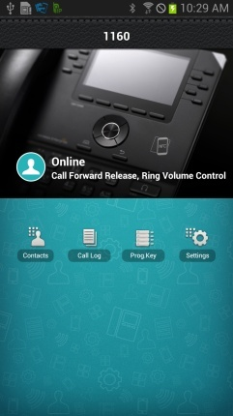
4. SDM Features
■ SDM (Samsung Deskphone Manager)
SDM is a smartphone application that allows a user to use the contacts, call log, or program keys and also do various settings by interoperating with SMT-i5343.
■ Key Functions
■ Please refer to SMT-i5343 User Guide for more details.
Menu | Description
Dashboard | You can check or change the name or status (presence) of a currently connected user and also use contacts, call log, or AOM menu.
Contacts | You can manage the contacts of a smartphone, WeWork, and DeskPhone.
Call Log | You can manage the call log of a smartphone and deskphone.
Program Key (AOM) | You can use the program key and AOM function of deskphone.
Settings | You can set up the details of SDM.

Slide 14
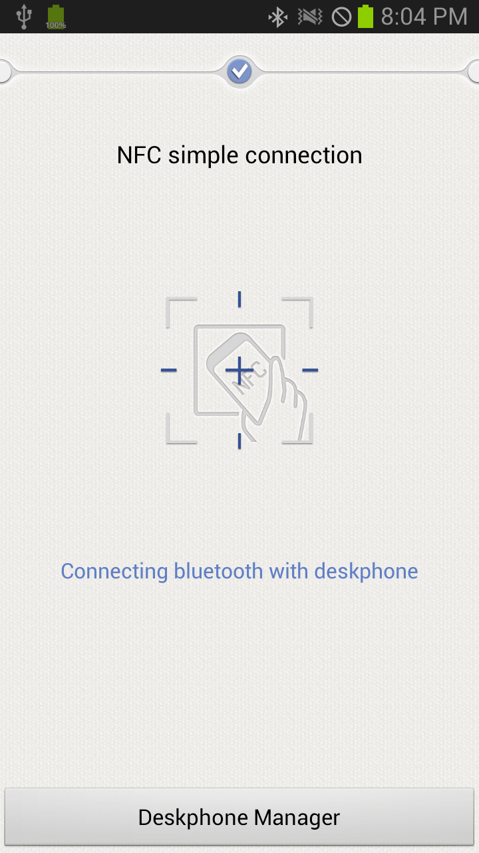
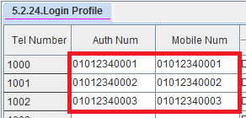
4. SDM Features
– NFC Simple Connection
■ NFC Simple Connection to register SDM
Simple connection is supported only by a smartphone. For NFC simple connection, a sim card must be installed and the mobile phone number must be registered in the system.
In case of OfficeServ7000, NFC Simple Connection is supported only by using WE VoIP for interoperating mobile phone number
Enter the mobile number in DM 5.2.24

Slide 15
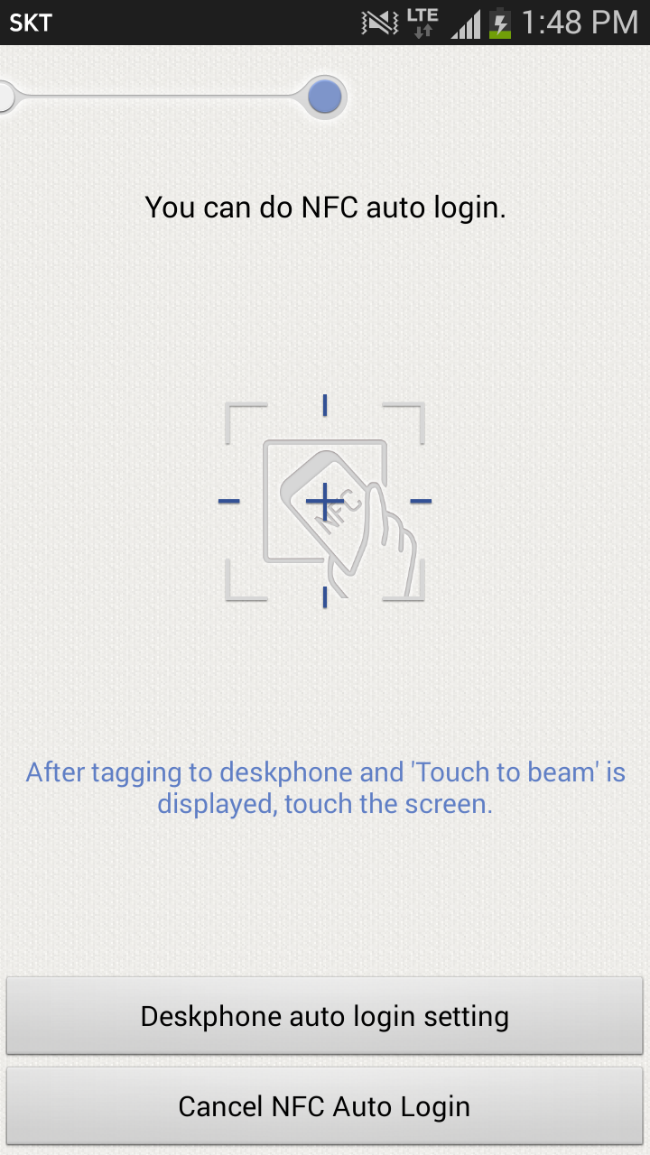
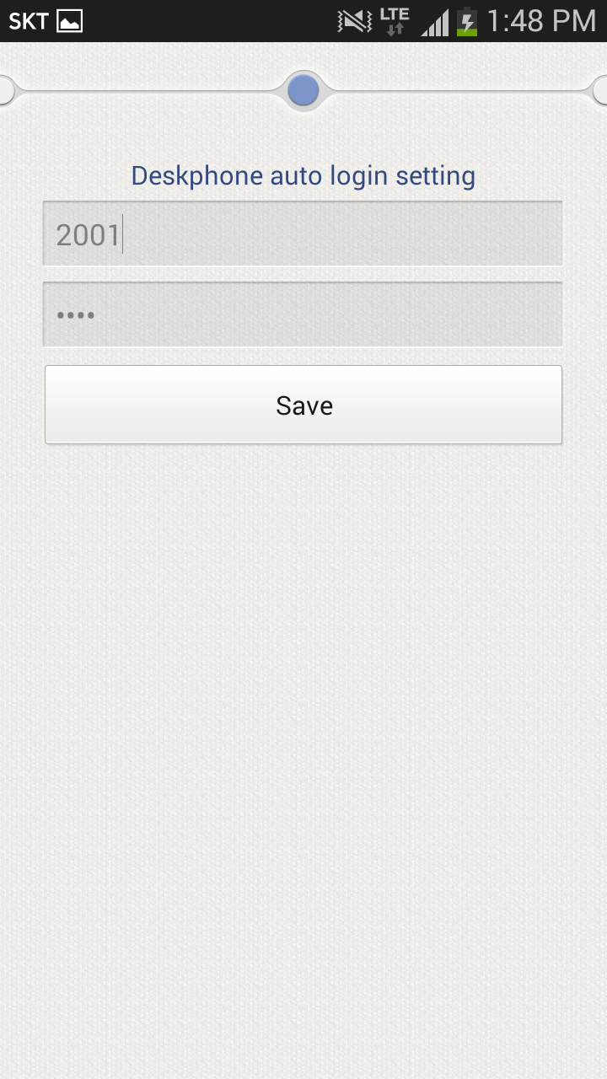
4. SDM Features
– Hot Desking
■ Hot Desking
The hot desking feature allows a subscriber to log in from a phone shared by multiple users.
You can use a phone in the logged out status to enter his/her ID and password to log in and use the phone as your own phone until logged out.
For Hot Desking Auto Login from SDM, You should register SDM to SMT-i5343 more than once or directly input the account for registration.
* You can log out using [Menu] → [Settings] → [Logout] menu.

Slide 16
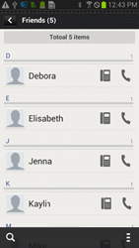
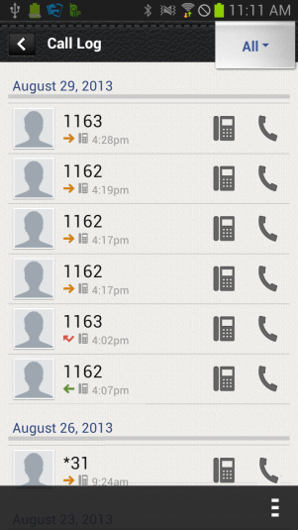
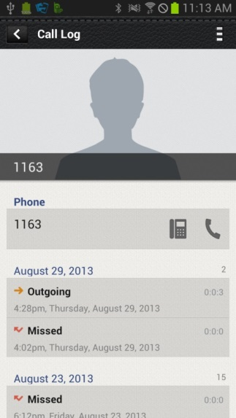
4. SDM Features
– SDM Dialing
■ SDM Dialing
- You can make a call from SMT-i5343 by touching SDM’s icon on the list of contacts or call log menu.

Slide 17
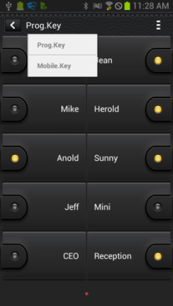
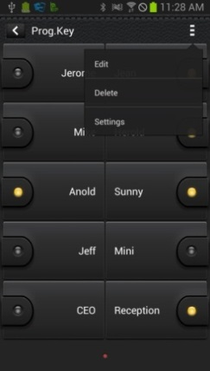
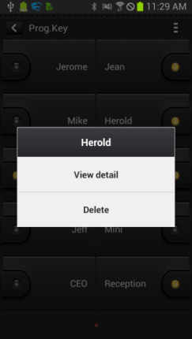
4. SDM Features
– Program Key (AOM)
■ Program Key (AOM)
You can use program keys and the AOM function.
Function | Description
Change device | You can change a device by pressing its name.
Change page | Using the left/right swipe at the top title bar, you can change a page.
Add function | You can add a function.
Long touch action | You can see the details and delete the information.
Edit/Delete | You can edit or delete a function.
Settings | Moves to the Settings screen.

Slide 18







